Slide 1


Customer Shopping Behavior Analysis
An End-to-End Data Analytics Project
Presented by Ankit Tripathi
Source Attribution: Based on Project by Amlan Mohanty (YouTube)

Slide 2
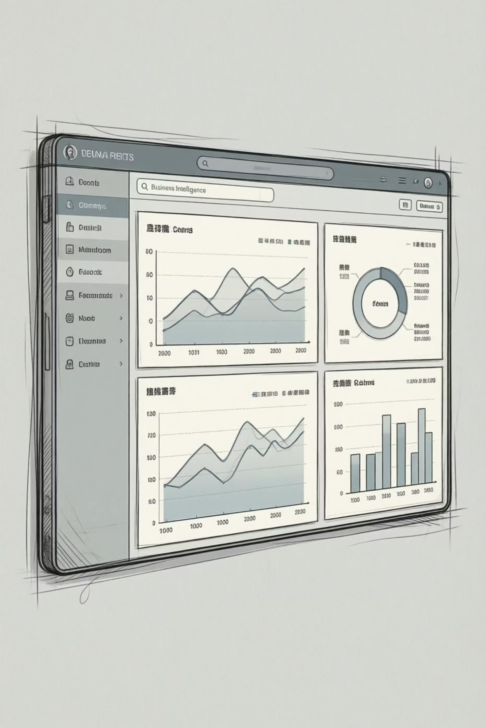
Project Overview & Objectives
1
2
Data Source
Primary Goal
Transactional data from 3,900 purchases.
Uncover insights into spending patterns, segments, and preferences.
3
Strategic Impact
Guide business decisions through data-driven understanding.

Slide 3


Dataset Summary: 3,900 Purchases
Our dataset comprises 3,900 rows and 18 columns, detailing various aspects of customer shopping behavior.
Customer Demographics: Age, Gender, Location, Subscription Status.
Purchase Details: Item, Category, Amount, Season, Size, Color.
Shopping Behavior: Discount, Promo Code, Previous Purchases, Frequency, Review Rating, Shipping Type.
Missing Data: 37 values in the Review Rating column were identified.

Slide 4
Exploratory Data Analysis (EDA) with Python
01
Data Loading & Initial Exploration
Imported dataset using pandas; used df.info() and .describe() for initial insights.
02
Missing Data Handling
Imputed missing 'Review Rating' values using the median rating per product category.
03
Column Standardization & Feature Engineering
Renamed columns to snake case. Created 'age_group' and 'purchase_frequency_days'.
04
Data Consistency & Integration
Dropped redundant 'promo_code_used'. Loaded cleaned data into MySQL for SQL analysis.

Slide 5
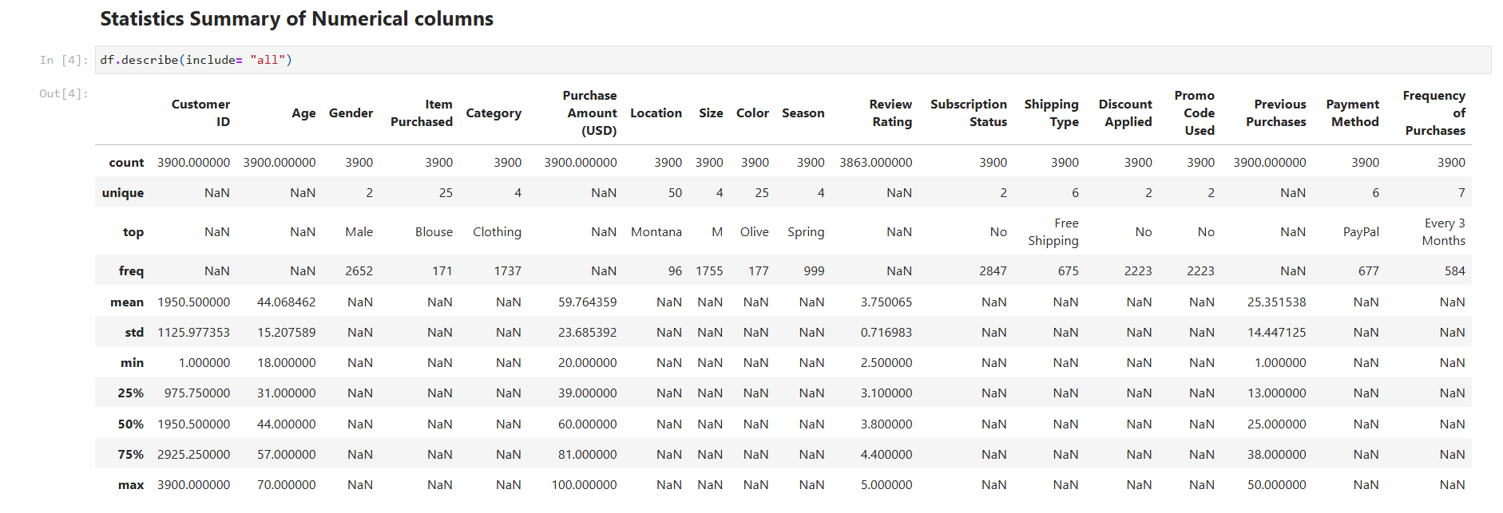
Statistics Summary of Numerical columns

Slide 6
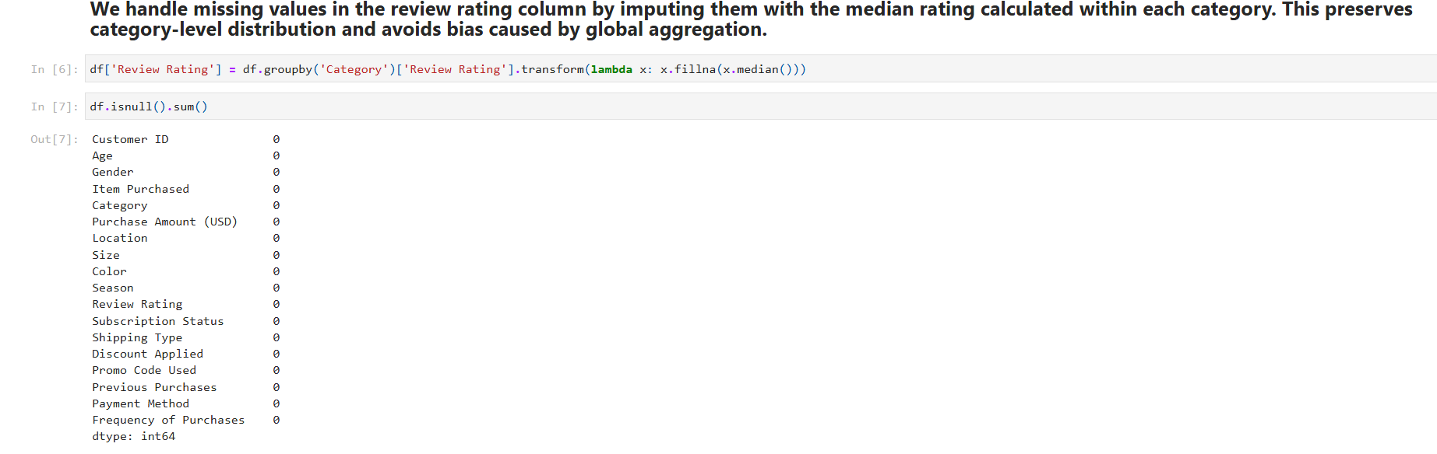
Handle missing values in the review

Slide 7
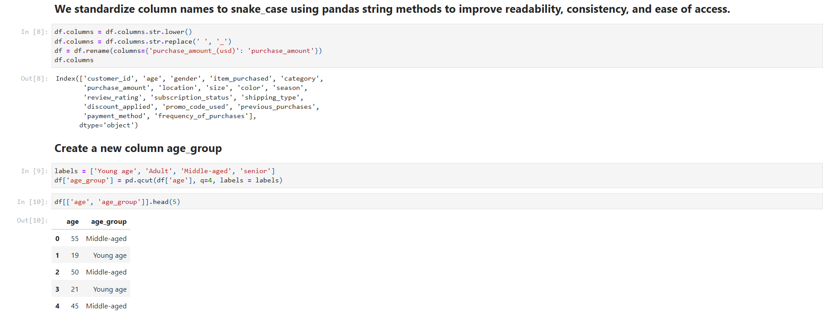
Standardize of columns & create a new column

Slide 8
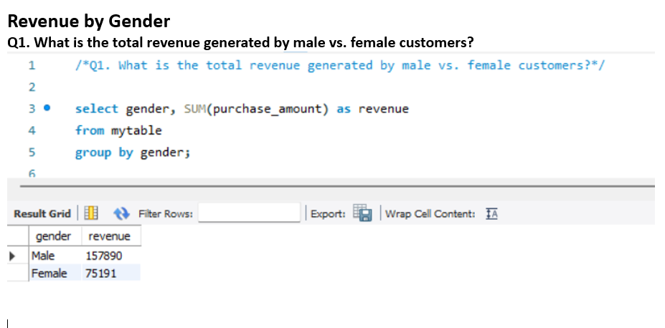

SQL Data Analysis: Key Business Questions
Structured analysis in PostgreSQL revealed critical insights into customer transactions.
Revenue by Gender
Total revenue generated by male vs. female customers.

Slide 9
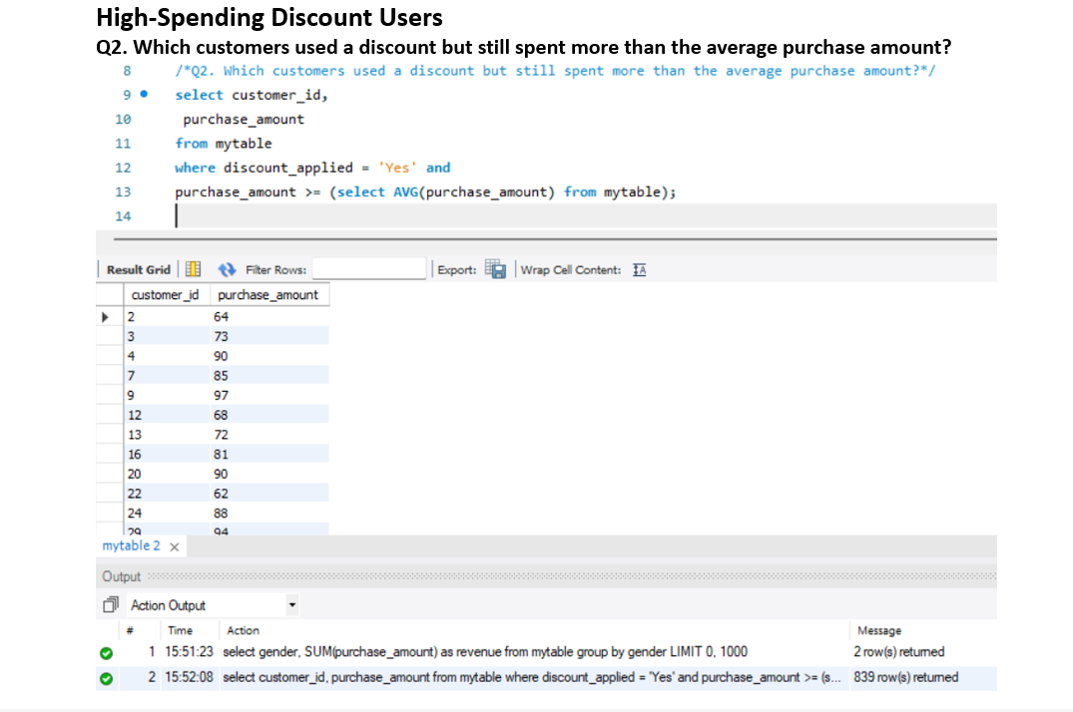
SQL Data Analysis: Key Business Questions
Structured analysis in PostgreSQL revealed critical insights into customer transactions.
High-Spending Discount Users

Slide 10

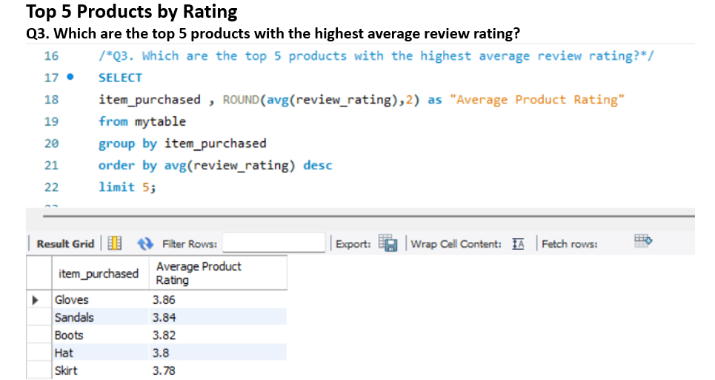
SQL Data Analysis: Key Business Questions
Structured analysis in PostgreSQL revealed critical insights into customer transactions.
Top 5 Products by Rating
Products with the highest average review rating.

Slide 11

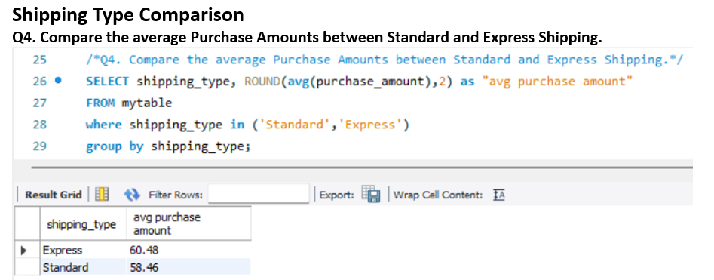
SQL Data Analysis: Key Business Questions
Structured analysis in PostgreSQL revealed critical insights into customer transactions.
Shipping Type Comparison
Average purchase amounts for Standard vs. Express Shipping.

Slide 12
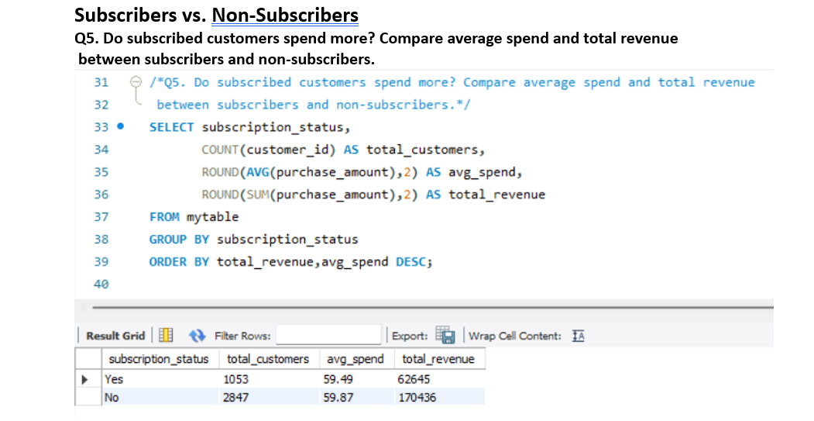
SQL Insights: Discounts, Subscriptions & Segmentation
Subscribers vs. Non-Subscribers: Compared average spend and total revenue.

Slide 13
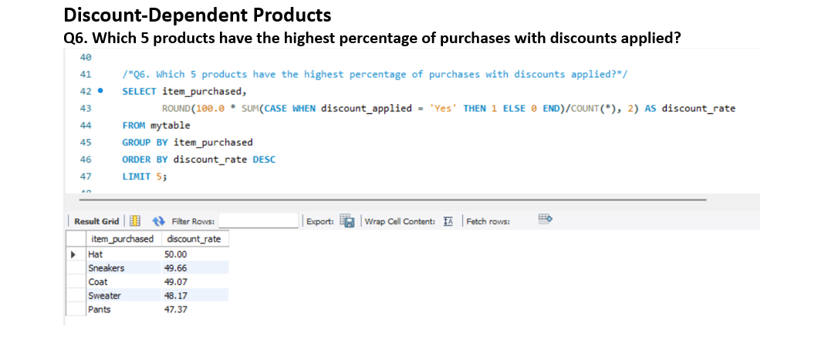
SQL Insights: Discounts, Subscriptions & Segmentation
Discount-Dependent Products: Top 5 products with highest percentage of discounted purchases.

Slide 14
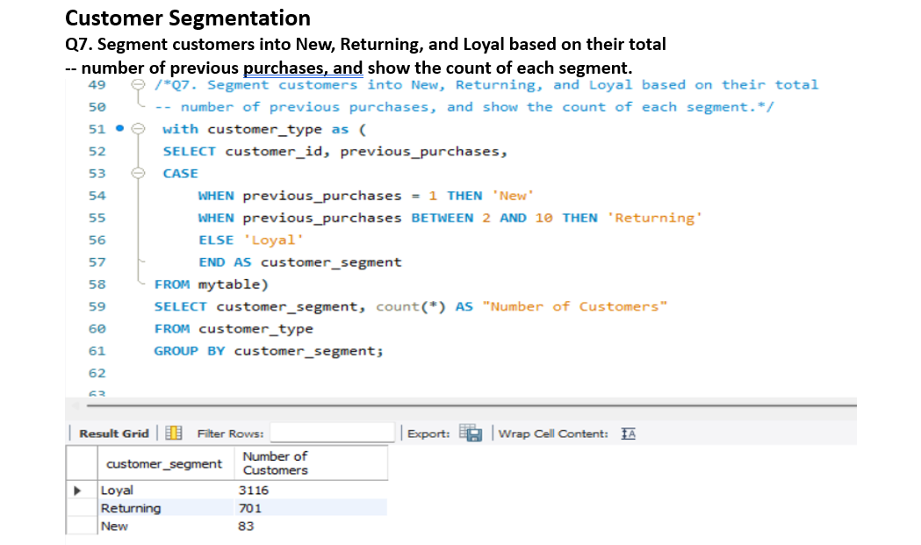
SQL Insights: Discounts, Subscriptions & Segmentation
Customer Segmentation: Categorized customers into New, Returning, and Loyal based on previous purchases.

Slide 15

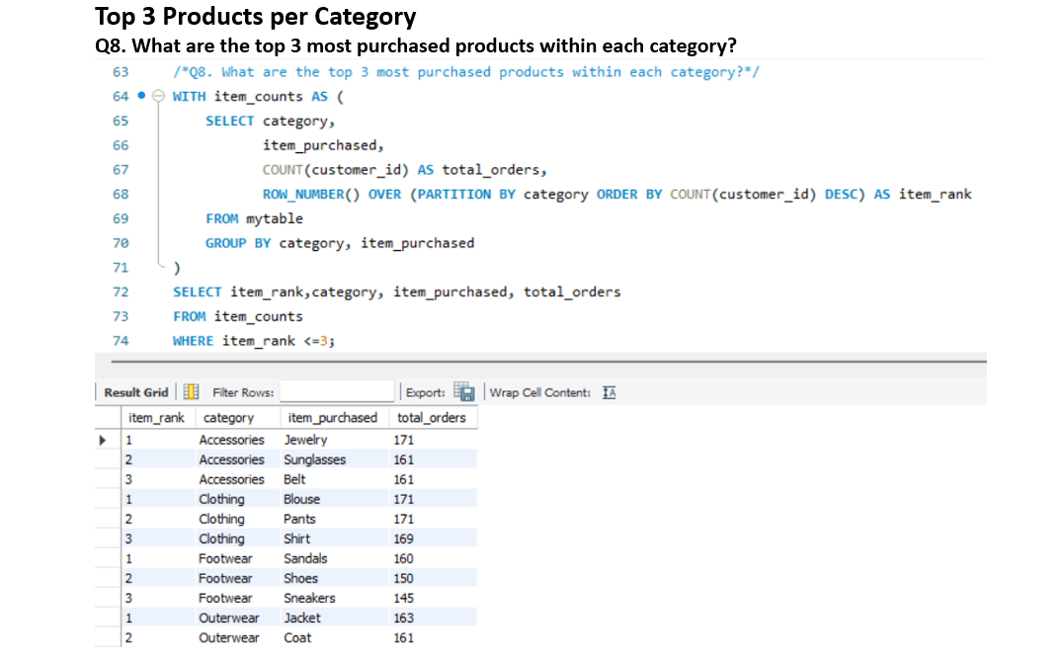
Product & Revenue Deep Dive
Top 3 Products per Category
Identified the most purchased products within each category.

Slide 16

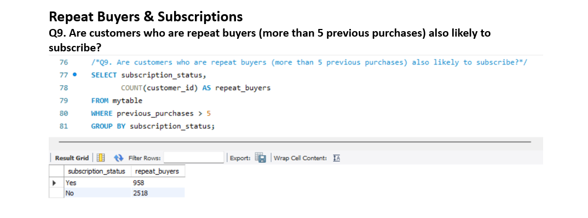
Product & Revenue Deep Dive
Repeat Buyers & Subscriptions
Analyzed if repeat buyers (5+ previous purchases) are likely to subscribe.

Slide 17

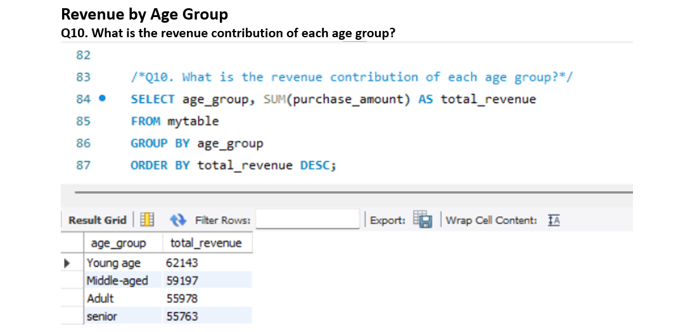
Product & Revenue Deep Dive
Revenue by Age Group
Determined the revenue contribution from different age demographics.

Slide 18
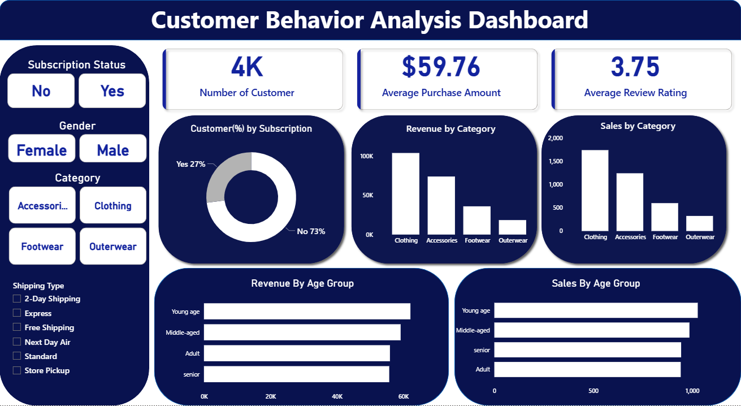
Interactive Dashboard in Power BI
Visualized key insights through an interactive Power BI dashboard, making complex data accessible and actionable.
This dashboard allows for dynamic exploration of customer behavior and performance metrics.

Slide 19


Business Recommendations: Driving Growth
Boost Subscriptions
Promote exclusive benefits to increase subscriber base.
Customer Loyalty Programs
Reward repeat buyers to foster loyalty and retention.
Review Discount Policy
Optimize discounts to balance sales with profit margins.

Slide 20

Targeted Strategies for Success
Product Positioning
Highlight top-rated and best-selling products in marketing campaigns.
Targeted Marketing
Focus efforts on high-revenue age groups and express-shipping users for maximum impact.
These recommendations aim to optimize marketing spend and enhance customer value.

Slide 21
Thank You!

